Slide 1

Lecture 13 raster Analysis lecture
Instructor: Yanan Wu
fALL 2025

Slide 2
13.1 raster analysis

Slide 3
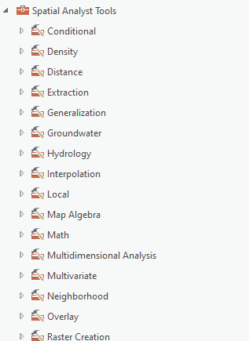
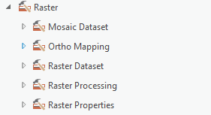
Overview
Raster Analysis
Raster math
Reclassification
Extraction
Neighborhood-based analysis
Distance
Raster generalization
Raster summarization
Estimating density
Mosaic
Spatial analysis tool

Slide 4
Neighborhood function Raster Generalization

Slide 5
Majority Filter
Only applicable to categorical raster grids
Replace center cell with majority value in 3 x 3 cell window
MAJORITY vs. HALF: Must have a majority or at least half to change value
FOUR vs. EIGHT: use just orthogonal cells or orthogonal and diagonal cells
Four: only orthogonal cells
Eight: both orthogonal and diagonal
Salt and pepper effect
30 | 20 | 30
30 | 20 | 20
40 | 30 | 20
Notes:
The raster generalization methods that we will discuss here are only applicable to categorical raster grids, such as land cover.
First, we will discuss majority filtering. Majority filtering can be used to replace a cell value with a different value based on neighboring cells.
Generally, this is performed using a 3 by 3 moving window, so this is another example of a method that makes use of neighborhood analysis.
Specifically, this method is used to replace a cell value with the majority cell value of the neighboring cells.
If the FOUR method is used, then only orthogonal cells will be considered. These are the cells that share a side with the center cell.
If the EIGHT method is used, then all eight neighboring cells will be considered, or the four orthogonal and four diagonal cells.
If the Majority setting is applied, then the cell value will only be changed if a majority or more than half of the neighbors contain the new cell value.
If the Half setting is used, then at least half of the neighboring cells must contain the cell value.
In the example provided here, if EIGHT and Majority were used then the cell value would be changed to 30. This is because 30 is the majority value in the eight neighboring cells, as five of the eight cells contain this value.
If the FOUR and majority method were used, then the center cell value would be maintained as 20, since there are two 30 and two 20 cells in regards to the orthogonal neighbors, so there is no majority.
Regardless of the settings used, the 3 by 3 moving window will move through the grid to perform this calculation using each cell as the center cell.
A common application of majority filtering is to reduce the salt and pepper effect that commonly results from image classification. Pixels that are different from their neighbors can be recoded to the majority value of their neighbors, thus reducing the salt and pepper issue.

Slide 6
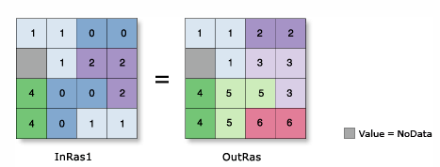
Region Group
Group cells with the same code in a categorical raster and code them with a unique identifier
Identify contiguous regions of the same category
Notes:
Region group is used to code all regions in a categorical raster to a unique code. So, any contiguous set of pixels that have the same code will be grouped, and each of these unique regions will be assigned a unique code.
The goal here is to identify contiguous regions of the same category.

Slide 7
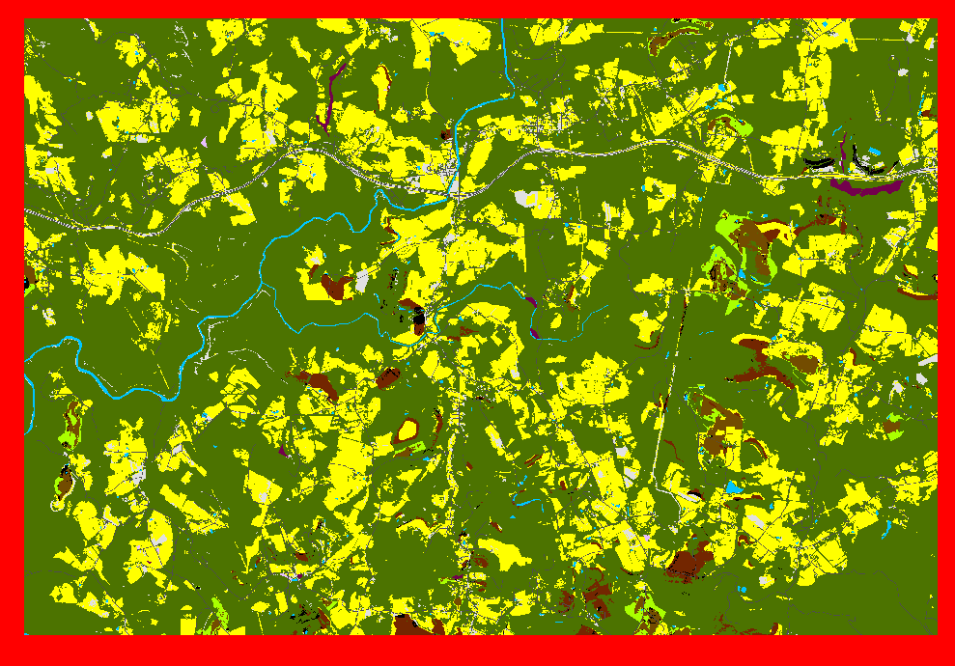
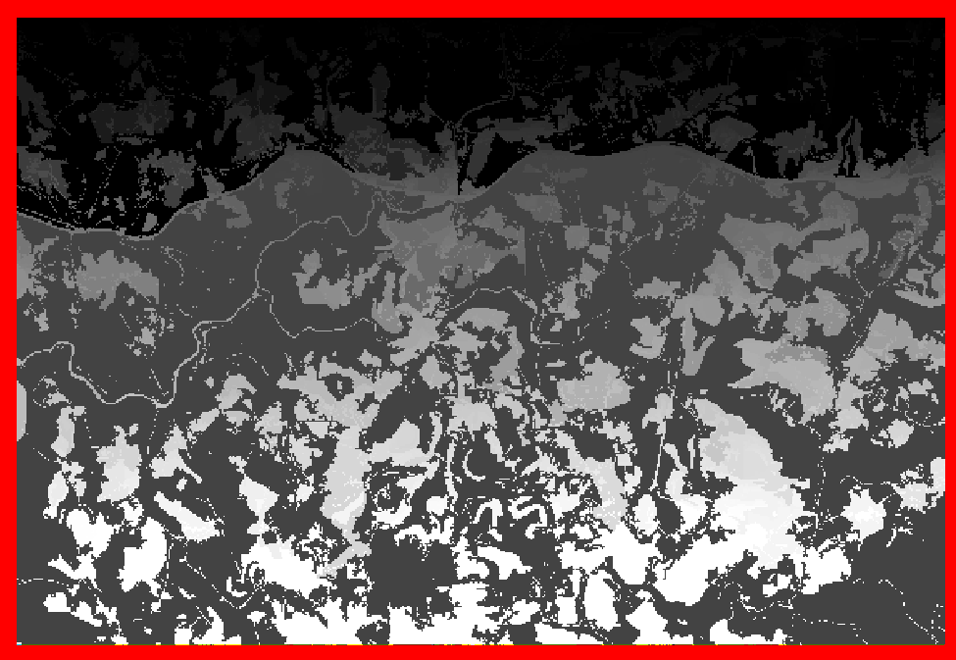
Region Group
Group cells with the same code in a categorical raster and code them with a unique identifier

Slide 8
Region Group
Must decide between the FOUR or EIGHT method
Four: area will only be considered contiguous if the cells share a side
Eight: area will be considered contiguous even if the pixels only touch diagonally
Can convert to polygons after regions are grouped
Will needed to decide if you want to simply the polygons
Notes:
When performing region grouping, similar to majority filtering, the FOUR or EIGHT methods can be applied.
If the EIGHT method is applied, an area of the same code will be considered contiguous even if the pixels only touch diagonally.
In contrast, when using the FOUR method an area will only be considered contiguous if the cells share a side, or are orthogonal.
Generally, the FOUR method will yield more unique regions than the EIGHT method.
Once regions have been assigned unique codes, they can be converted to polygons with or without simplification.
If no simplification is applied, then the polygons will follow the boundaries of the cells.
Defines connectivity between cells of the same value only if the cells are directly to the left, right, above, or below each of the four nearest neighbors. If two cells with the same value are diagonal from one another, they are not considered connected.

Slide 9
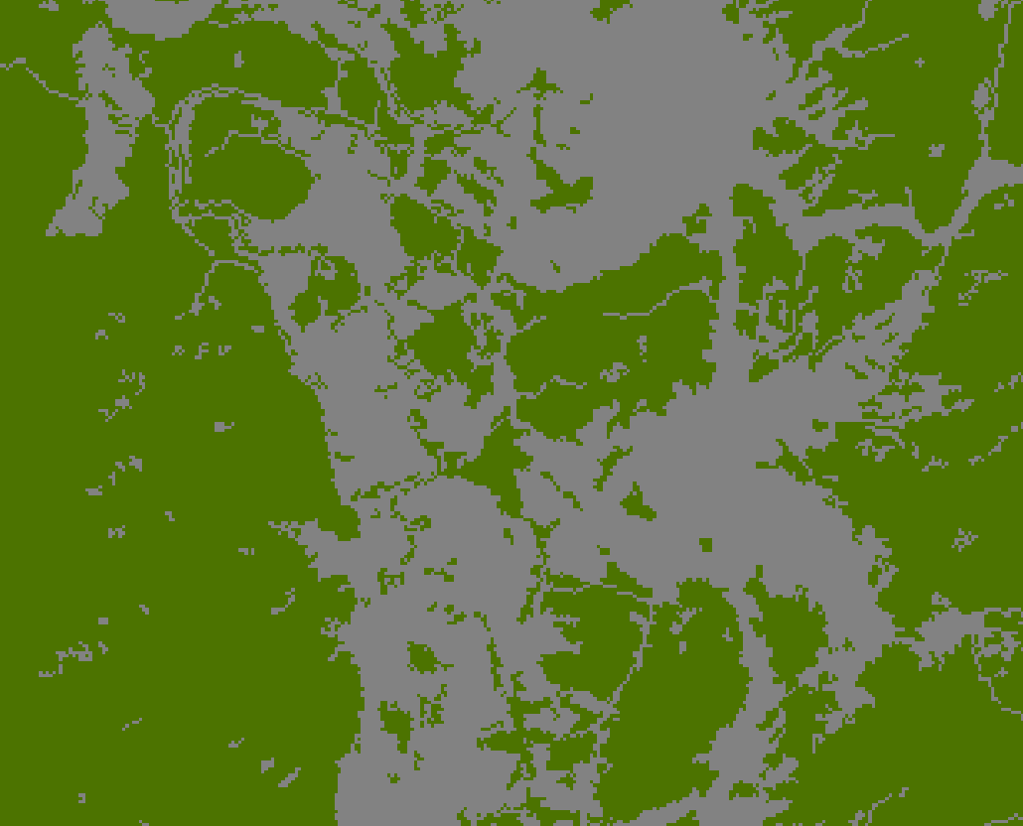
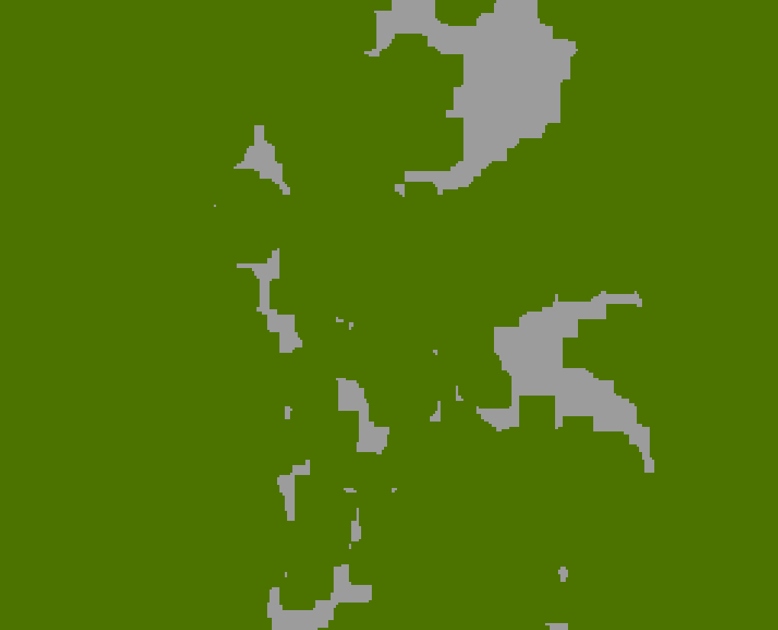
Expand
Expand out a specific category in a categorical raster by a specified number of cells
Green expanded by 5 30 m pixels
Notes:
Expand is used to extend a certain code or category out by a defined number of cells.
In the example provided, the green cells represent forest and the gray cells represent all other categories.
Using Expand, the forest areas have been expand by 5 cells or 150 meters, reducing the area of not forest.

Slide 10
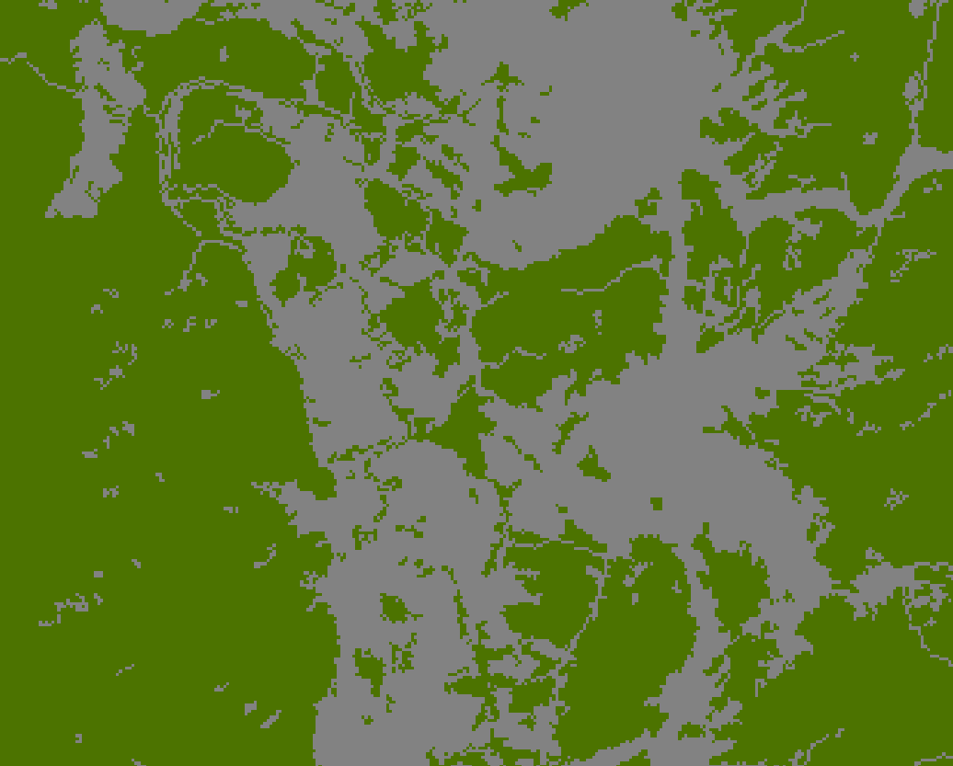
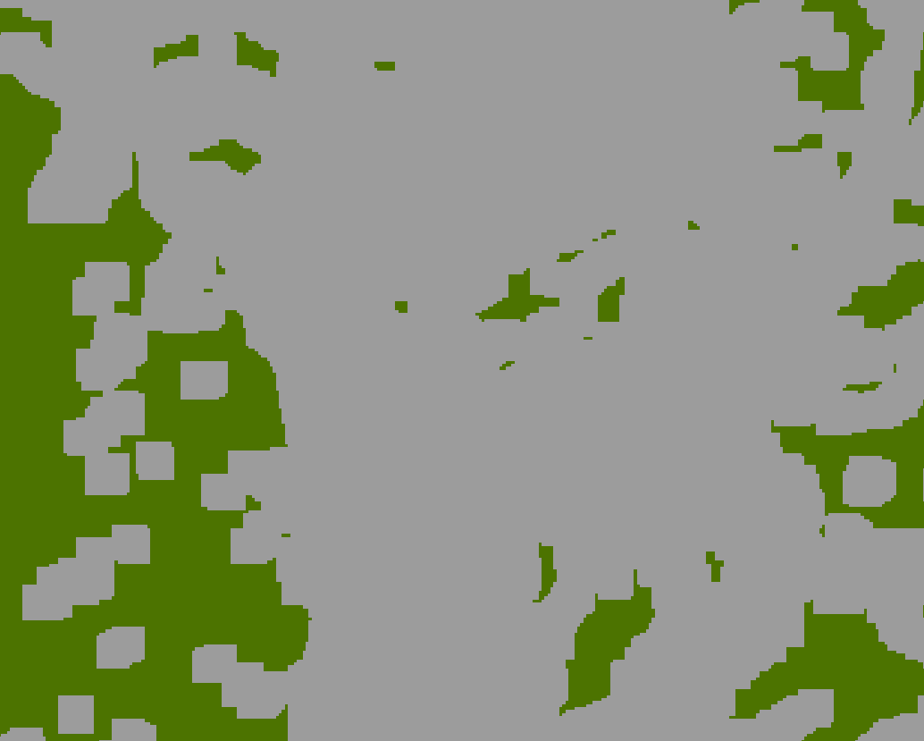
Shrink
Shrink a specific category in a categorical raster by a specified number of cells by replacing them with the values of the cell that is most frequent in its neighborhood
Green shrank by 5 30 m pixels and replaced with gray
Notes:
Shrink is the opposite of expand. Instead of expanding areas with a certain code or value, that code or value is reduced.
The areas that are reduced for this class are replaced with the most frequent value or code in its neighborhood.
In the example above, the forest class has been reduced by 5 cells or 150 meters. Cells in these areas have been recoded as not forest.

Slide 11
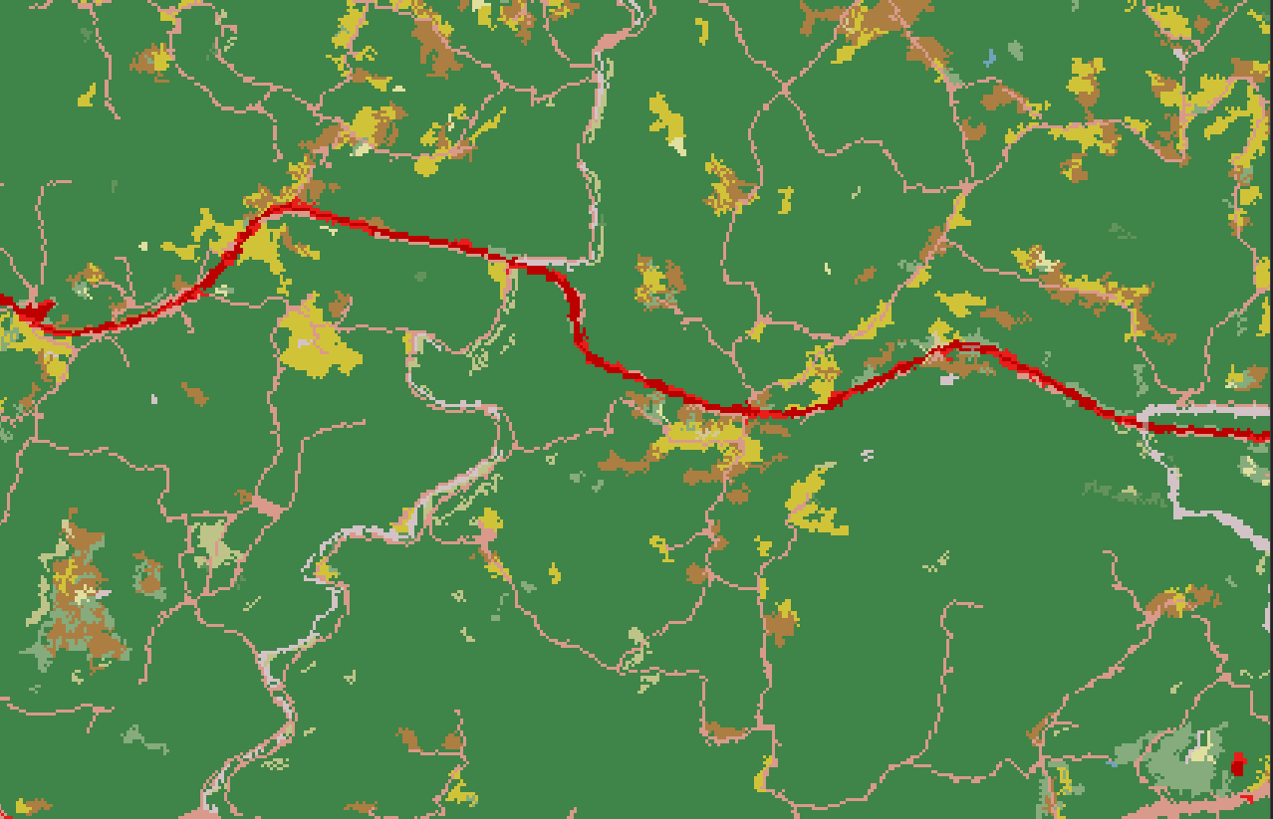
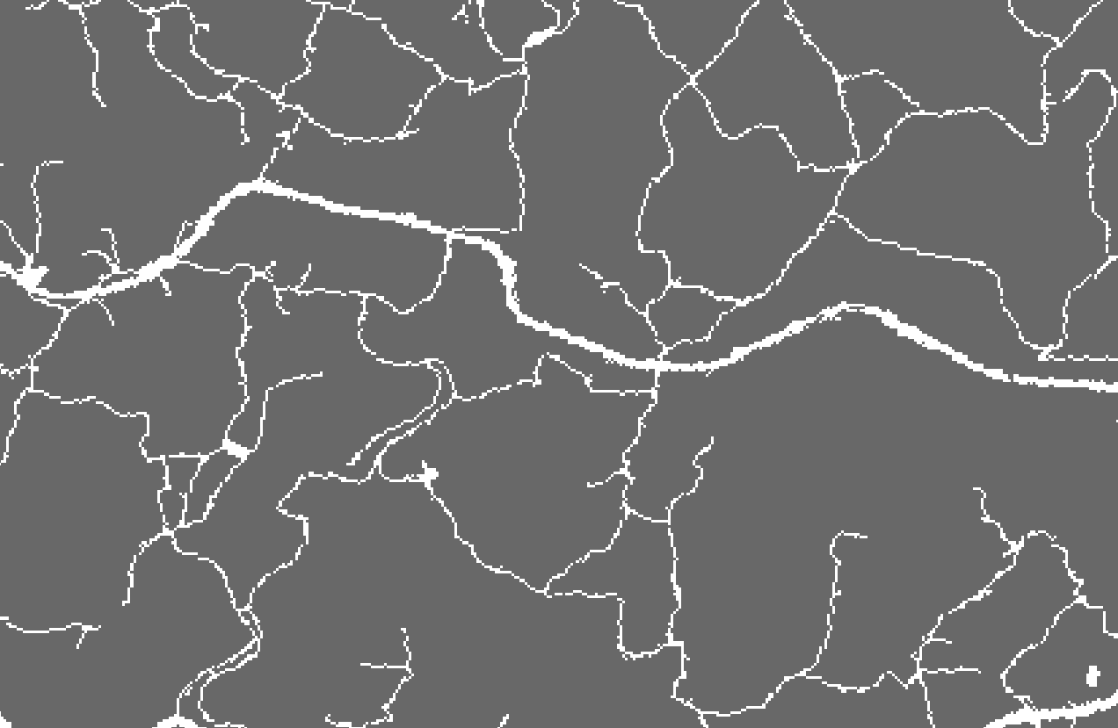
Nibble
Replace cells of a raster corresponding to a mask with the values of the nearest neighbor
Notes:
Nibble is used to replace cells values with the nearest cell value that is not masked out.
In the example above, the red areas indicate some level of development. We would like to remove these areas and replace them with the nearest non-developed category.
To accomplish this task, a mask is produced. This mask is used to mask out all developed areas.
Using this mask, areas that are developed will be recoded as the nearest code that is not developed, since all developed areas were masked out.
Progress to the next slide to see the result.

Slide 12
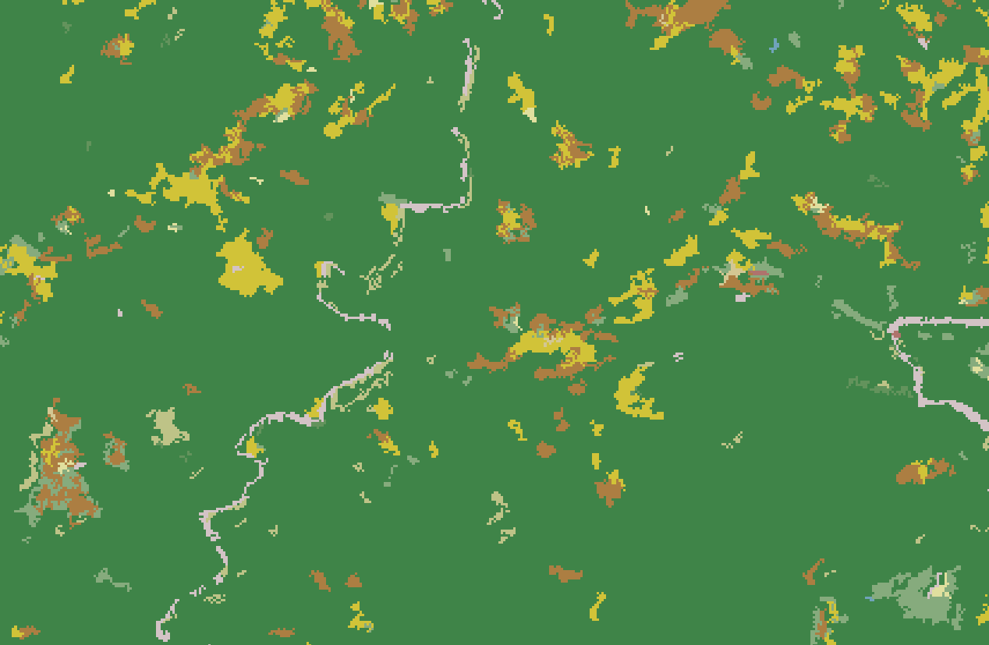
Nibble
Replace cells of a raster corresponding to a mask with the values of the nearest neighbor
Notes:
As you can see, the developed cells have now been replaced by the nearest non-developed category, effectively removing this class from the dataset.

Slide 13
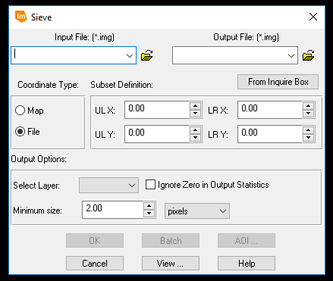
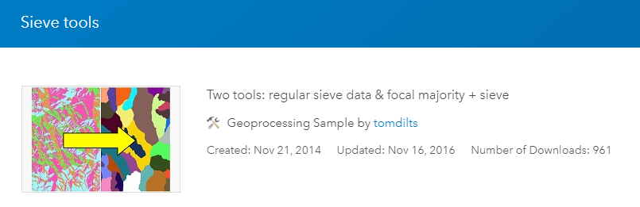
Sieving
Replace regions smaller than a certain size in a categorical raster with the surrounding class
Can be used to approximate a minimal mapping unit (MMU)
Notes:
As a last example of raster generalization methods, sieving can be used to remove areas of the same category that are smaller than a certain size.
The user must define a minimal size area to maintain as a land area or number of cells.
The tool will then find all contiguous regions that are smaller than this defined size. Once these areas are found they will be removed and assigned to the surrounding class.
As an example, this tool could be used to remove small areas in a land cover classification that are smaller than a defined size. For example, small barren areas within a forested extent could be removed and coded as forest.
This method can be used to remove the salt and pepper effect common in land cover classifications.
Additionally, this method can be used to approximate a minimal mapping unit. Areas smaller than the minimal mapping unit can be recoded and assigned to the surrounding class.

Slide 14
Neighborhood function Raster summarization

Slide 15
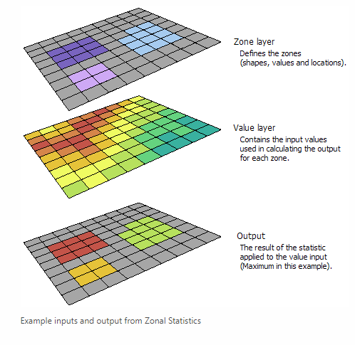
Zonal statistics
Used to obtain statistics from a continuous raster within an area or zone as defined by another raster or a polygon vector layer
Can obtain results as a raster surface for a single statistic
All cells in the zone have same value
https://desktop.arcgis.com/en/arcmap/10.3/tools/spatial-analyst-toolbox/h-how-zonal-statistics-works.htm
Notes:
A common spatial analysis task is to summarize raster data relative to vector data. For example, you may want to summarize continuous raster data relative to polygons.
This can be accomplished using the Zonal Statistics Tool.
This method will calculate a statistical measure, such as the mean, median, standard deviation, minimum, or maximum, from the cell values within a zone.
The zones can be defined using a categorical raster or vector polygons. If vector polygons are used, then they will be converted to raster zones prior to the summarization.
As a result, this method generally will not work correctly if overlapping polygons are used, since only one code can be assigned to each cell.
The result will be a statistical measure that will be the same for each cell within each zone.
The example above shows the range of elevation for each county in West Virginia. Since the zones were defined as counties, all cells in the same county were assigned the same value, in this case the elevation range.
Since a singe band raster is produced, only one statistical measure can be generated at a time.

Slide 16
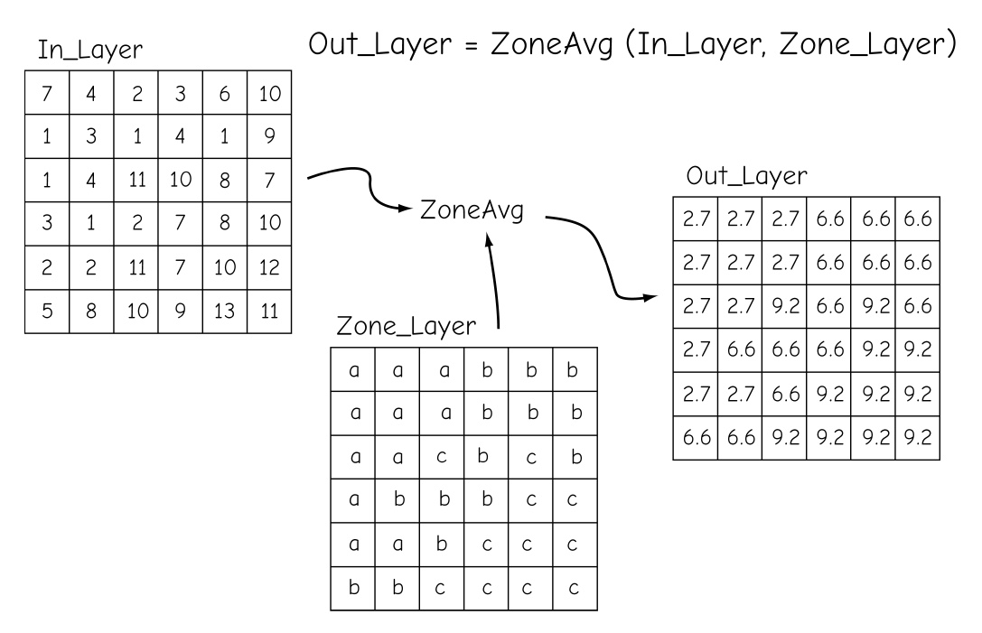
Zonal statistics
Bolstad, 2019
Notes:
A common spatial analysis task is to summarize raster data relative to vector data. For example, you may want to summarize continuous raster data relative to polygons.
This can be accomplished using the Zonal Statistics Tool.
This method will calculate a statistical measure, such as the mean, median, standard deviation, minimum, or maximum, from the cell values within a zone.
The zones can be defined using a categorical raster or vector polygons. If vector polygons are used, then they will be converted to raster zones prior to the summarization.
As a result, this method generally will not work correctly if overlapping polygons are used, since only one code can be assigned to each cell.
The result will be a statistical measure that will be the same for each cell within each zone.
The example above shows the range of elevation for each county in West Virginia. Since the zones were defined as counties, all cells in the same county were assigned the same value, in this case the elevation range.
Since a singe band raster is produced, only one statistical measure can be generated at a time.

Slide 17
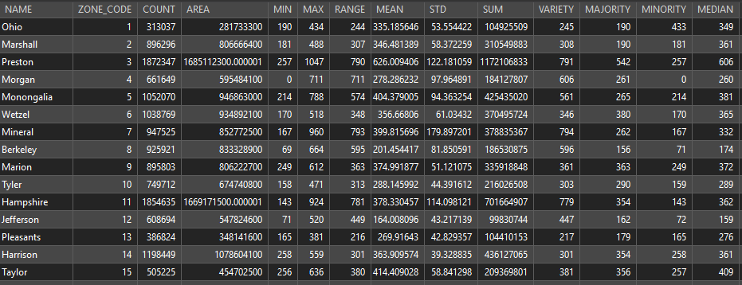
Zonal Statistics as Table
Used to obtain statistics from a continuous raster within an area or zone as defined by another raster or a polygon vector layer
Can obtain multiple statistics as a table: mean, majority, maximum, median, minimum, minority, range, standard deviation, sum, and variety
Can use table join to join the results back to the zone data
Elevation statistics by county
Notes:
If you would like to calculate multiple statistics in a table format, this can be accomplished using Zonal Statistics as Table.
Instead of producing a raster output for a single statistical measure, a table output is generated that can provide multiple statistical measures.
Each row in the table will correspond to a zone, in this example a specific county.
If you would like to associate these results with the original zones, this can be accomplished using a table join. Here, this table could be joined back to the county vector file using the shared NAME field.

Slide 18
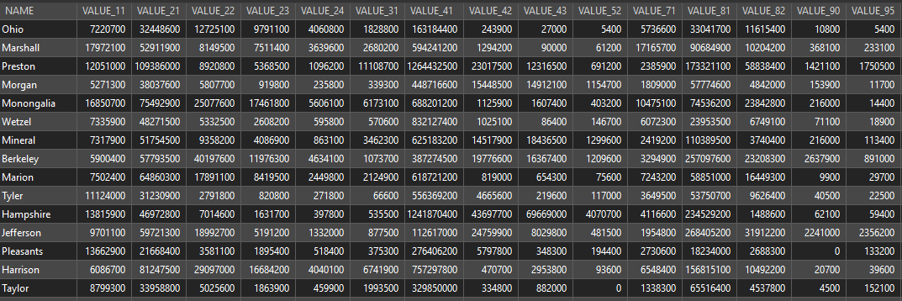
Tabulate Area
Used to obtain areas for categories in a categorical raster within an area or zone as defined by another raster or polygon vector layer
Areas will be in square map units
Can use table join to join the results back to the zone data
Area of land cover by county
Notes:
The Zonal Statistics tools are designed to provide summary statistics relative to zones and are generally more applicable for summarizing continuous raster data, such as a digital elevation model.
If you would like to summarize categorical raster data, such as land cover, this can be accomplished using the Tabulate Area Tool.
The output will be a table that provides the land area of each category within each zone.
If you would like to obtain the percentage of the land area as opposed to the area, then you could perform table calculations in new fields.
This table could also be joined to the original zone using a table join for further analysis.
Similar to the Zonal Statistics tools, vector polygon zones will be converted to raster zones to perform the summarization. So, incorrect results will be produced for overlapping polygons.

Slide 19
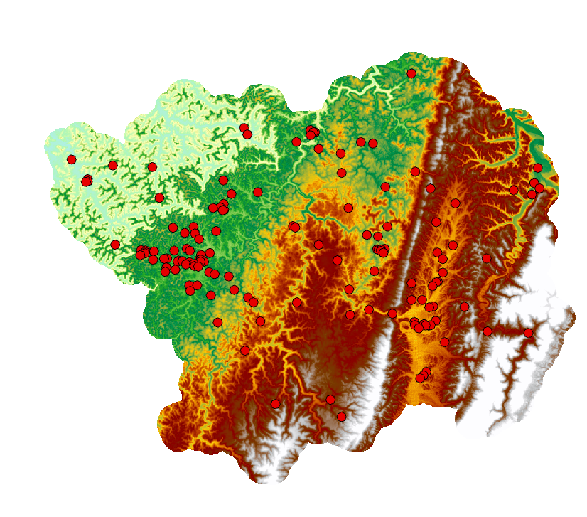
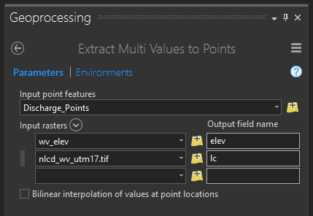

Extract Values to Points
Extract raster values at point locations and add the data to the attribute table
Can use: Extract Multi Values to Points Tool or Extract Values to Points Tool
Notes:
It is also possible to extract values at points. The result will be a new field in the attribute table for the point layer that holds the cell value from a raster grid occurring at that location.
This is an easy way to extract cell values at point locations in preparation for later analysis.

Slide 20
Neighborhood function Estimating Densities

Slide 21
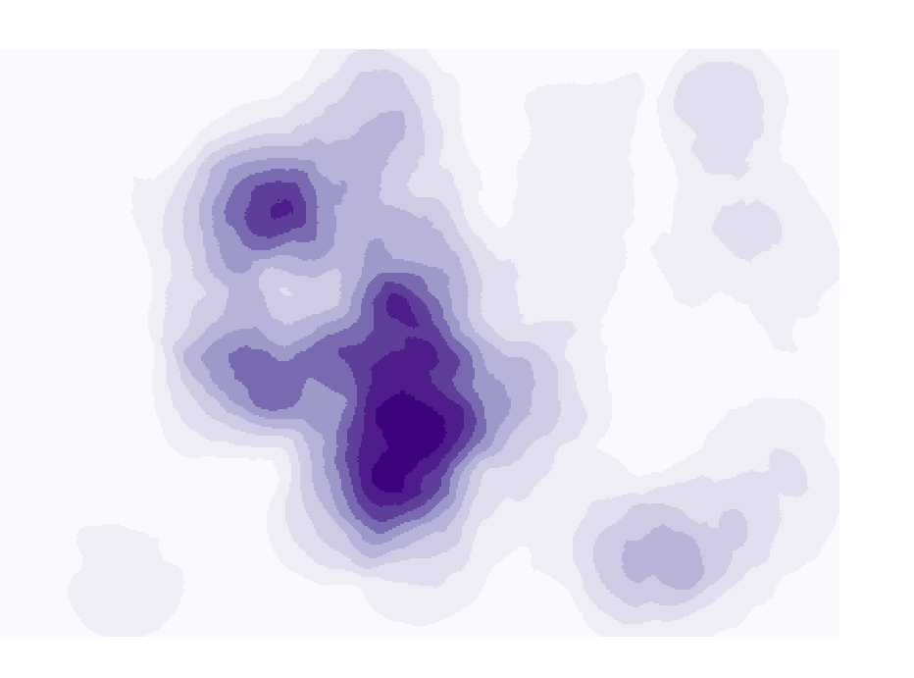
Point Density/ Line Density
Calculates the magnitude per unit area for point or line features that fall within a neighborhood around each cell
Line length/area
Number of points/area
Can incorporate weights
Must specify neighborhood shape and size
Notes:
You may be interested in obtaining a raster-based measure of density for point or line features. This can be accomplished using the Point Density or Line Density tools.
These tool are yet another example of methods that make use of neighborhood analysis or moving windows.
The user must define the size and shape of the moving window. The tool then will calculate the number of points or length of lines within the window.
On the center cell for each window, the tool will return a measure of density. For points this will be the number of points per unit area.
For lines, this will be the length of lines per unit area.
The size and shape of the window can have a large impact on the output. More global or generalized patterns will be produced with larger windows whereas more local patterns will be observed if a smaller window is used.
There is not necessarily a correct window size, as this depends on the goals of the analysis.

Slide 22
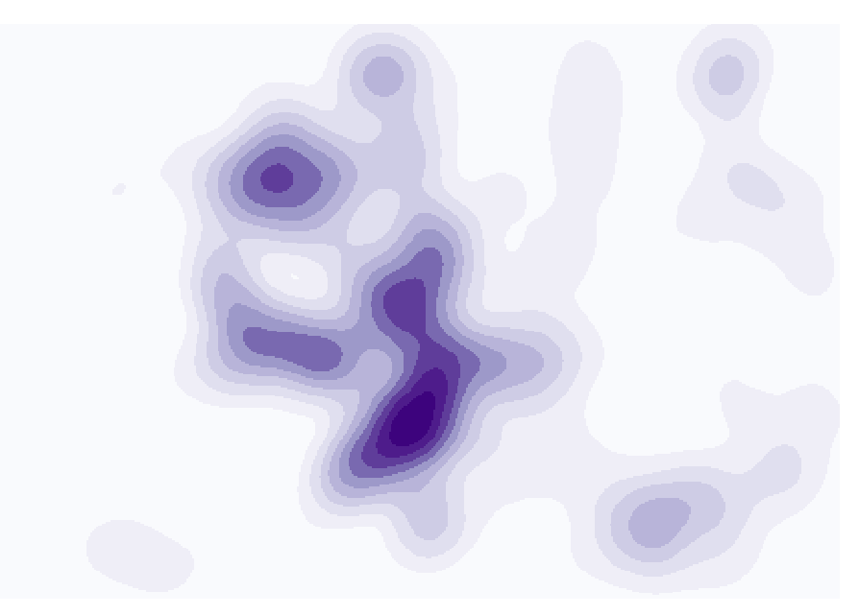
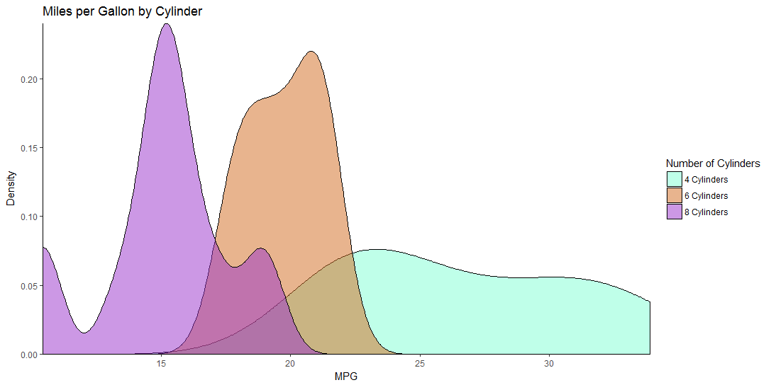
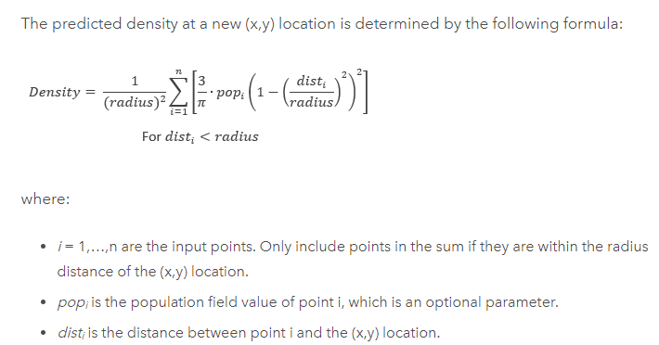
Kernel Density
Fits a kernel function to estimate density
Notes:
Kernel density is similar to point or line density, accept that a different method is used to calculate density.
Specifically, this method makes use of a kernel function. The next slide provides and explanation of this method.
Please take the time to read through this explanation.

Slide 23
Mosaic

Slide 24
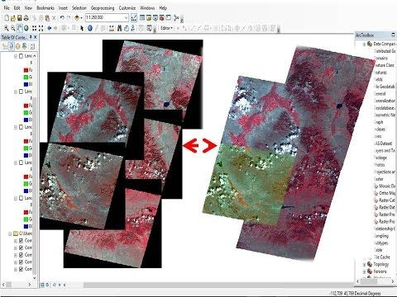
Mosaic to New Raster
Combine single band or multiband raster grids into a single raster
Can be used for all types or raster grids, including images
https://www.pinterest.com/pin/326440672980405218/
Notes:
Instead of extracting a portion of a raster grid, you might be interested in combining multiple raster grids. This is a common task performed for image data. As another example, multiple digital elevation models could be merged to create an elevation surface that fills a larger spatial extent. This process can be accomplished using the Mosaic to New Raster Tool.
This tool will require you to define a pixel type (8-bit, 16-bit, float, etc.), a file extension (I commonly use Image or TIFF), an output cell size, and the number of bands.

Slide 25
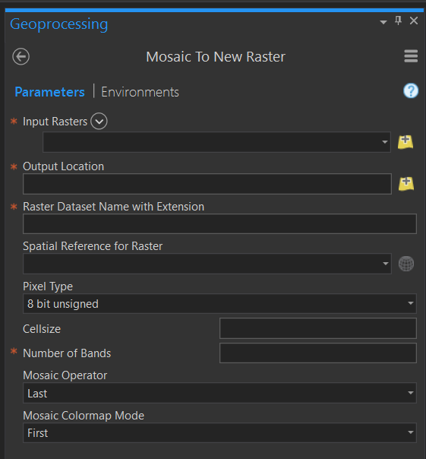
Mosaic to New Raster
Must specify: file extension, pixel type, cell size, and number of bands
Notes:
Instead of extracting a portion of a raster grid, you might be interested in combining multiple raster grids. This is a common task performed for image data. As another example, multiple digital elevation models could be merged to create an elevation surface that fills a larger spatial extent. This process can be accomplished using the Mosaic to New Raster Tool.
This tool will require you to define a pixel type (8-bit, 16-bit, float, etc.), a file extension (I commonly use Image or TIFF), an output cell size, and the number of bands.

Slide 26
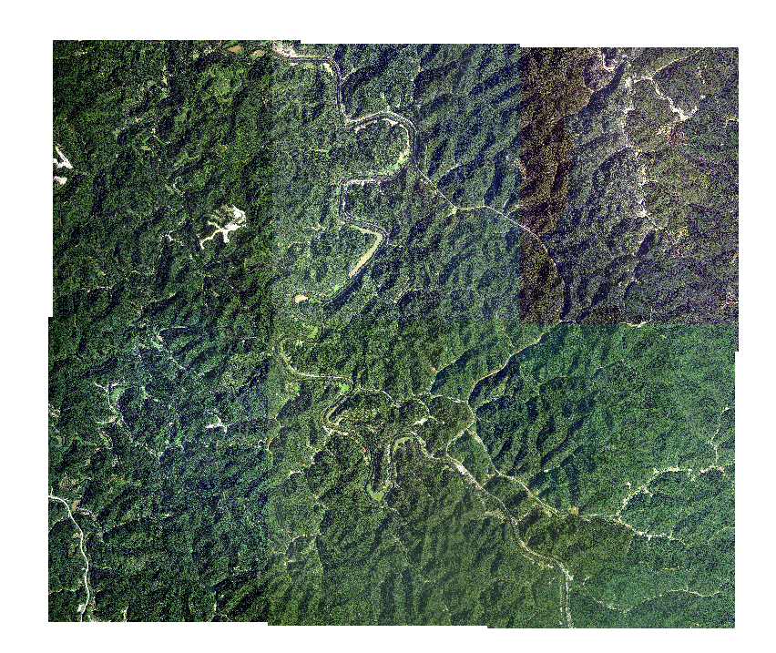
Mosaic to New Raster
Assigning values at overlapping locations:
FIRST: The output cell value of the overlapping areas will be the value from the first raster dataset mosaicked into that location.
LAST: The output cell value of the overlapping areas will be the value from the last raster dataset mosaicked into that location. This is the default.
BLEND: The output cell value of the overlapping areas will be a horizontally weighted calculation of the values of the cells in the overlapping area.
NAIP Orthophotography
Notes:
When you have overlapping values, a method must be applied to obtain the cell value in the overlapping areas. When there is no overlap, the decision is easy, as there is only on cell value.
For continuous data, many methods are available, including first, last, mean, maximum, and minimum. Since categorical data cannot be averaged, first or last are commonly used.
Take some time to review the methods described on the slide.

Slide 27
Mosaic to New Raster
Assigning values at overlapping locations:
MEAN: The output cell value of the overlapping areas will be the average value of the overlapping cells.
MINIMUM: The output cell value of the overlapping areas will be the minimum value of the overlapping cells.
MAXIMUM: The output cell value of the overlapping areas will be the maximum value of the overlapping cells.
SUM: The output cell value of the overlapping areas will be the total sum of the overlapping cells.
NAIP Orthophotography
Categorical data: first or last are commonly used.
Continuous data: All methods are ok
Demonstration!
Notes:
When you have overlapping values, a method must be applied to obtain the cell value in the overlapping areas. When there is no overlap, the decision is easy, as there is only on cell value.
For continuous data, many methods are available, including first, last, mean, maximum, and minimum. Since categorical data cannot be averaged, first or last are commonly used.
Take some time to review the methods described on the slide.

Slide 28
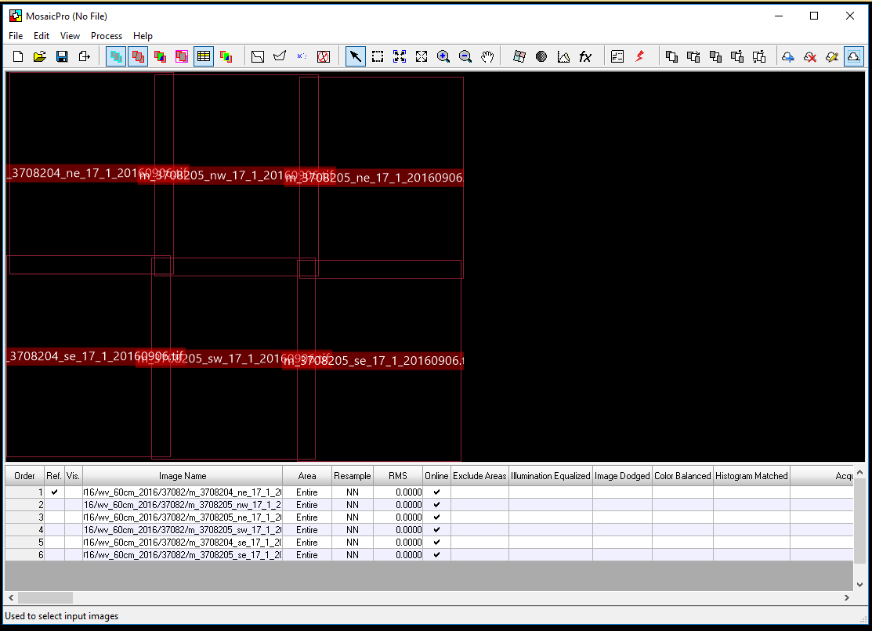
Mosaic Outside of ArcGIS
Erdas Imagine
ENVI
Notes:
As a note, other tools are available to mosaic raster data. The Mosaic Pro Tool within Erdas Imagine is commonly used to mosaic image data. I have found this tool to be fast. It also offers more advanced color balancing methods that can be of great value when combining images. It also allows you to write the result to multiple files as opposed to a single, continuous dataset. This is valuable if the output will be very large.

Slide 29
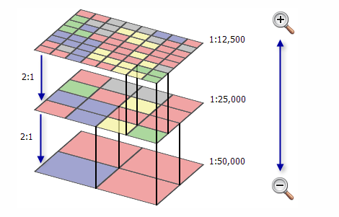
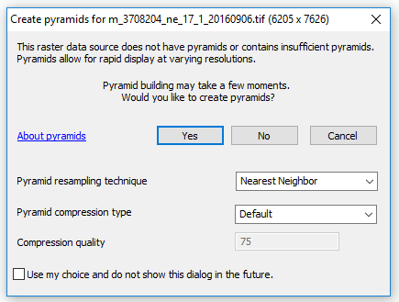
Pyramids
Reduce spatial resolution versions of the data to aid in faster display
Notes:
Raster datasets can be large files, especially if they cover a large spatial extent and/or have a small cell size. This can result in slow display.
Building pyramid layers provides a means to improve the display speed and performance or raster layers.
Pyramids are reduced spatial resolution versions of the data. When you are zoomed out, the reduce resolution data are drawn. The high spatial resolution data are not drawn until you zoom in.
This can greatly improve display speed as you zoom in and out or pan around.
If you plan to work with raster data, especially if you will need to zoom and pan around the data, such as when digitizing, I highly recommend building pyramids. This process can be slow, but it may save you time in the long run.

Slide 30
Spatial Analysis Tools

Slide 31







Software Options
ArcGIS Pro
ArcMap
Erdas Imagine
ITT ENVI
QGIS/GRASS/SAGA
R
Logos were obtained from organization websites.
Notes:
There are many other environments that are available in which to perform spatial analysis and work with raster data.
Although we mainly work with ArcGIS Pro in this course, I wanted to take the time to note some other options.
There are several open-source and free software packages that can be used to perform spatial analysis, including QGIS and R.
Additionally, spatial analysis methods focused on imagery are provided by remote sensing software packages, such as Erdas Imagine and ENVI.
You will be introduced to these tools in our more advanced courses.

Slide 32
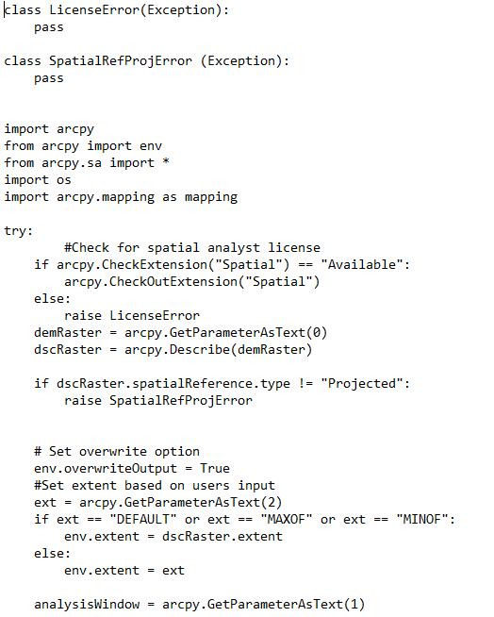

Python
https://esripress.esri.com/display/index.cfm?fuseaction=display&websiteID=276&moduleID=0
Script by Jeff Evans
Notes:
Lastly, spatial analysis can be performed in a code-based environment.
Using ESRI products, including ArcGIS Pro, Python can be applied to undertake a variety of tasks.
Python can be especially useful if you need to loop through data layers or automate a sequence of steps.
Python will be investigated in some of our more advanced courses.

Slide 33

Thank you!

